Slide 1
A Importância e Desafios na Identificação da Paciente com Câncer de Mama Her2-Low
Marina De Brot, MD PhD
CREMESP: 185569
Patologista Titular e Professora do Programa de Pós-Graduação do A.C.Camargo Cancer Center
Presidente da Associação dos Patologistas do Estado de São Paulo (APESP)
Secretária-Geral da Sociedade Brasileira de Patologia (SBP)
Secretária da International Society of Breast Pathology (ISBP)

Slide 2

Marina De Brot – 31 de maio de 2024
Declaração de Conflito de Interesse
Apresentações científicas – Como palestrante: AstraZeneca, Novartis, MSD
Como membro de Advisory Boards: Daiichi Sankyo
Declaro não ter ações em bolsa de valores das empresas supracitadas

Slide 3
Atualização em Câncer de Mama: HER2-Low
HER2
  Reconhecido fator prognóstico negativo no câncer de mama
  Alvo de terapias anti-HER2
  Estudos sobre o câncer de mama HER2+ e surgimento das drogas anti-HER2 nos anos 90: mudaram a história natural e evolução das pacientes com esta doença
Hormonetherapy
Patient-related factors
RH+
Chemotherapy
Breast cancer
HER2+
Anti-HER2 therapy + CT or HT
TN
Immunotherapy
BRCA status
Chemotherapy
Marchiò C. et al. Seminars in Cancer Biology 72 (2021) 123–135
Notes:
The human epidermal growth factor receptor 2 (HER2) is a well-known negative prognostic factor in breast cancer and a target of the monoclonal antibody trastuzumab as well as of other anti-HER2 compounds. Pioneering works on HER2-positive breast cancer in the 90s’ launched a new era in clinical research and oncology practice that has reshaped the natural history of this disease. In diagnostic pathology the HER2 status is routinely assessed by using a combination of immunohistochemistry (IHC, to evaluate HER2 protein expression levels) and in situ hybridization (ISH, to assess HER2 gene status). For this purpose, international recommendations have been developed by a consensus of experts in the field, which have changed over the years according to new experimental and clinical data. In this review article we will document the changes that have contributed to a better evaluation of the HER2 status in clinical practice, furthermore we will discuss HER2 heterogeneity defined by IHC and ISH as well as by transcriptomic analysis and we will critically describe the complexity of HER2 equivocal results. Finally, we will introduce the clinical impact of HER2 mutations and we will define the upcoming category of HER2-low breast cancer with respect to emerging clinical data on the efficacy of specific anti- HER2 agents in subgroups of breast carcinomas lacking the classical oncogene addition dictated by HER2 amplification.
HER2 downstream pathway activation, anti-HER2 targeted agents. HER2 is a ligand-orphan transmembrane tyrosine kinase receptor belonging to the Human Epidermal Receptor (HER) family. HER2 homo- or hetero-dimerization with one of the other three receptors (HER1 or EGFR, HER3 and HER4), triggers the activation of different signaling pathways that are associated with cell proliferation, invasion and survival of cancer cells [1,106]. Therapeutic approaches, based on the modulation of HER2 activation, include different targets of the protein. Monoclonal antibodies bind the extracellular domain of HER2, with a selective antigen preference for trastuzumab or pertuzumab, leading to a reduction of the signaling cascade [107]. Antibody-drug conjugates are designed to release the drug after internalization by the tumor cell, with the decrease of systemic side effects. The small molecules tyrosine kinase inhibitors (TKIs), such as lapatinib and neratinib, inhibit the catalytic activity of the HER2 receptor in a reversible or irreversible way, respectively, through the specificity for the ATP binding site of the kinase domain [108]. ADC: Antibody-Drug Conjugate. This image has been created with BioRender.

Slide 4
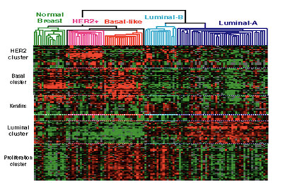
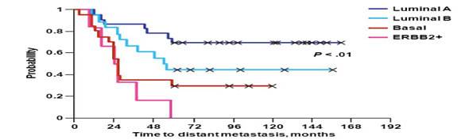
Câncer de Mama HER2-Positivo
Câncer de mama superexpressor de HER2: cerca de 15% dos carcinomas invasivos
Associação com pior prognóstico e comportamento biológico agressivo
Oportunidade de uso de terapias anti-HER2
Melhor marcador preditivo: amplificação/superexpressão de HER2
Status HER2: IHQ e ISH
  Únicos métodos com validação clínica reconhecida
  Recomendações da ASCO/CAP
  Desde 2007
Perou et al, Nature 2010; Sorlie et al, PNAS 2013; Marchiò C. et al, Seminars in Cancer Biology 72 (2021)
Notes:
The human epidermal growth factor receptor 2 (HER2) is a well-known negative prognostic factor in breast cancer and a target of the monoclonal antibody trastuzumab as well as of other anti-HER2 compounds. Pioneering works on HER2-positive breast cancer in the 90s’ launched a new era in clinical research and oncology practice that has reshaped the natural history of this disease. In diagnostic pathology the HER2 status is routinely assessed by using a combination of immunohistochemistry (IHC, to evaluate HER2 protein expression levels) and in situ hybridization (ISH, to assess HER2 gene status). For this purpose, international recommendations have been developed by a consensus of experts in the field, which have changed over the years according to new experimental and clinical data. In this review article we will document the changes that have contributed to a better evaluation of the HER2 status in clinical practice, furthermore we will discuss HER2 heterogeneity defined by IHC and ISH as well as by transcriptomic analysis and we will critically describe the complexity of HER2 equivocal results. Finally, we will introduce the clinical impact of HER2 mutations and we will define the upcoming category of HER2-low breast cancer with respect to emerging clinical data on the efficacy of specific anti- HER2 agents in subgroups of breast carcinomas lacking the classical oncogene addition dictated by HER2 amplification.
HER2 downstream pathway activation, anti-HER2 targeted agents. HER2 is a ligand-orphan transmembrane tyrosine kinase receptor belonging to the Human Epidermal Receptor (HER) family. HER2 homo- or hetero-dimerization with one of the other three receptors (HER1 or EGFR, HER3 and HER4), triggers the activation of different signaling pathways that are associated with cell proliferation, invasion and survival of cancer cells [1,106]. Therapeutic approaches, based on the modulation of HER2 activation, include different targets of the protein. Monoclonal antibodies bind the extracellular domain of HER2, with a selective antigen preference for trastuzumab or pertuzumab, leading to a reduction of the signaling cascade [107]. Antibody-drug conjugates are designed to release the drug after internalization by the tumor cell, with the decrease of systemic side effects. The small molecules tyrosine kinase inhibitors (TKIs), such as lapatinib and neratinib, inhibit the catalytic activity of the HER2 receptor in a reversible or irreversible way, respectively, through the specificity for the ATP binding site of the kinase domain [108]. ADC: Antibody-Drug Conjugate. This image has been created with BioRender.

Slide 5
The Expanding Armamentarium of Anti-HER2 Agents for Breast Cancer

Slide 6
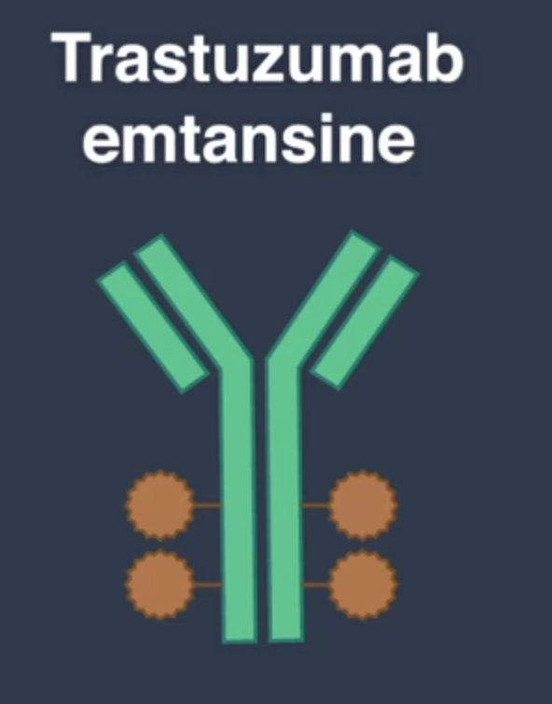
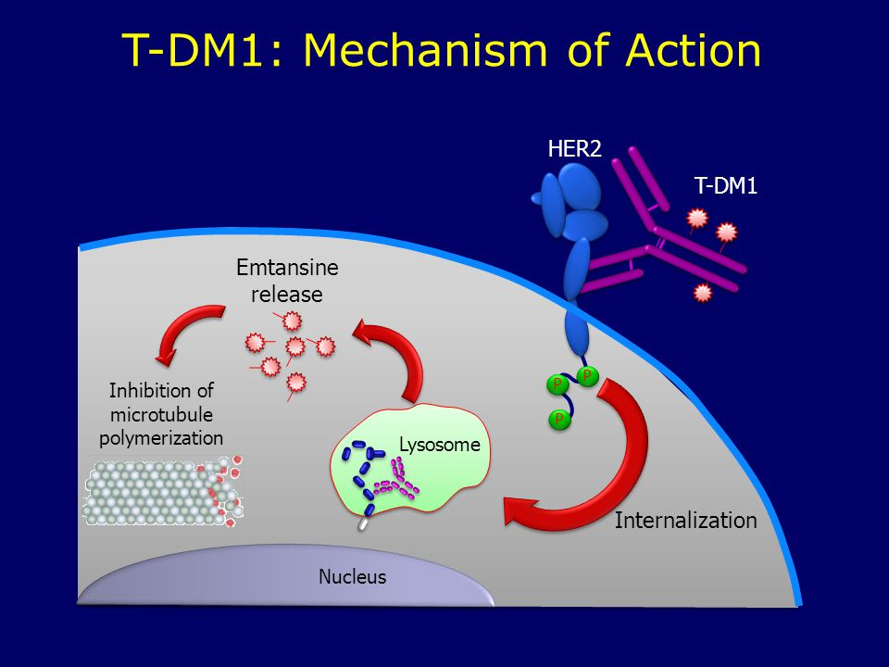
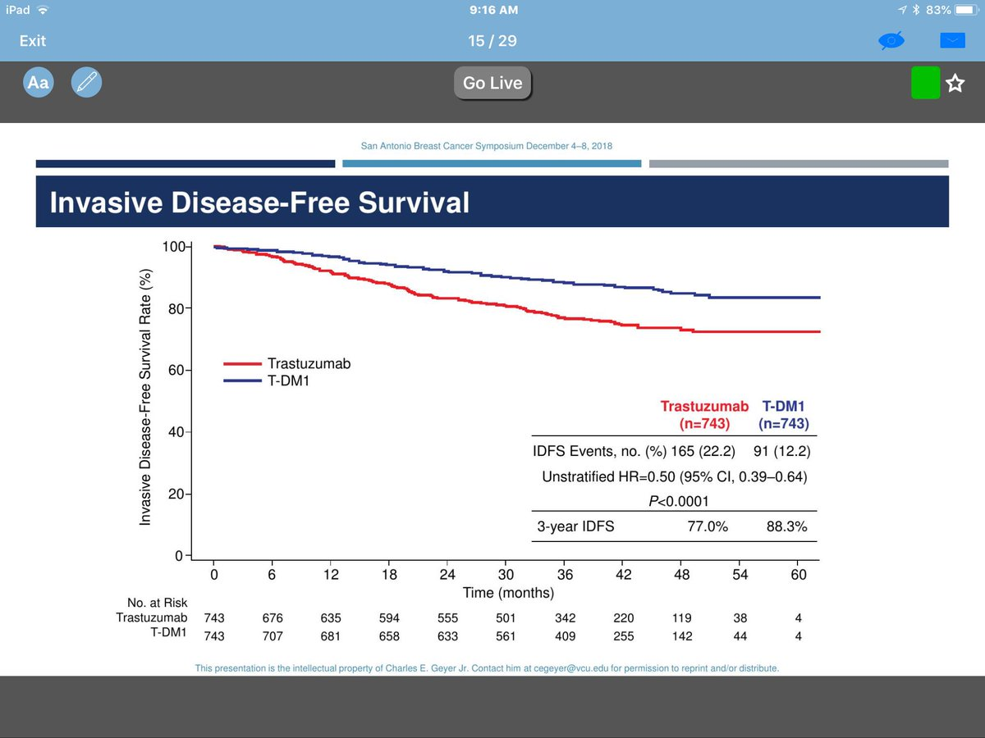
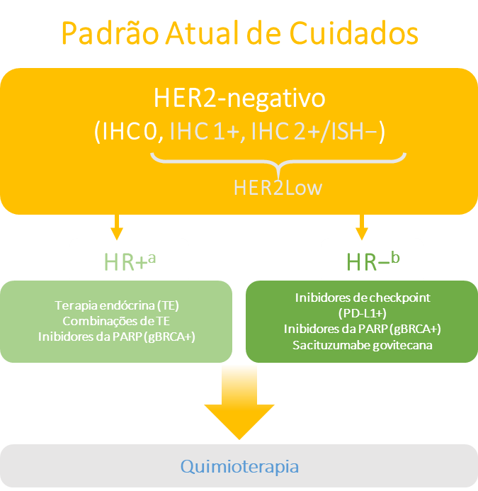
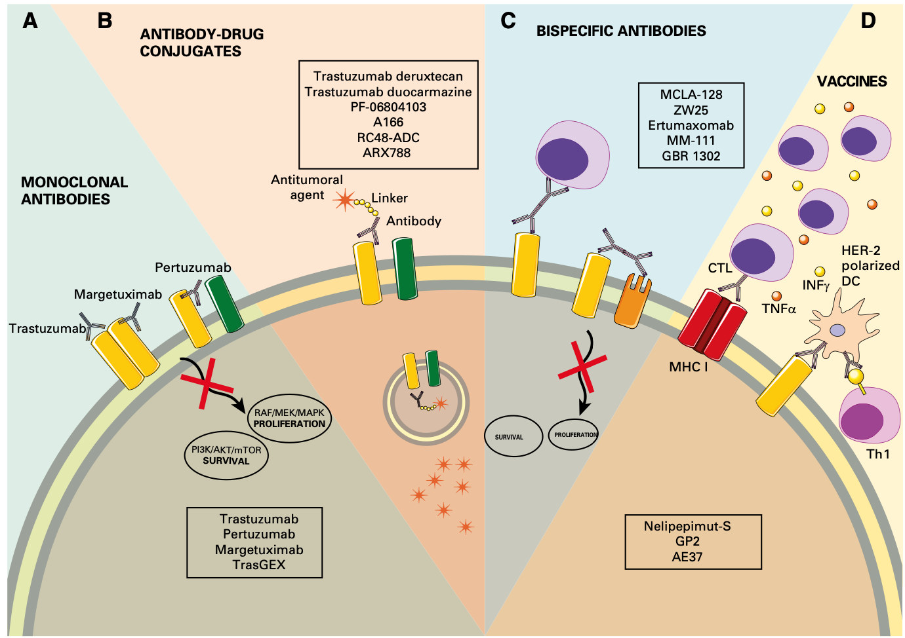
Novos Compostos Anti-HER2
Inicially offered only to patients with metastatic
HER2+ breast cancer or in clinical trials
Antibody drug conjugates = ADCs
  Monoclonal antibodies engineered to enhance antibody-dependent cellular cytotoxicity
  Designed to target and release the drug directly to neoplastic cells: reduce systemic exposure to cytotoxic agents
  First class of drugs: T-DM1 (association of trastuzumab + emtansine - DM1)
  Evidences of good response rates also in BCs with low expression of HER2
  “HER2-Low” breast cancer
KATHERINE trial
3y IDFS= 77% vs 88%
Marchiò C. et al Seminars in Cancer Biology 72 (2021) 123–135
von Minckwitz et al N Engl J Med 2019;380(7):617-628
Notes:
Other ADCs have been introduced, such as trastuzumab duocarmazine (SYD-985) and trastuzumab deruxtecan (DS-8201), which have demonstrated encouraging response rates not only in HER2-positive but also in the so called “HER2-low” breast cancer patients
Desenvolvimento de outros compostos anti-HER2: T-DM1
Associação do trastuzumabe com a emtansina (DM1): o conjugado limita a liberação da DM1 (agente citotóxico), aumentando e direcionando a ação para as células-alvo
Essa seletividade é um grande diferencial do mecanismo de ação desse medicamento: permite que ele seja mais eficaz e muito menos tóxico do que a QT tradicional
Empregado na doença HER2+ avançada, metastática e, mais recentemente, no TTO adjuvante: câncer de mama HER2+ inicial com doença invasiva residual pós-terapia neoadjuvante baseada em taxano e trastuzumabe

Slide 7
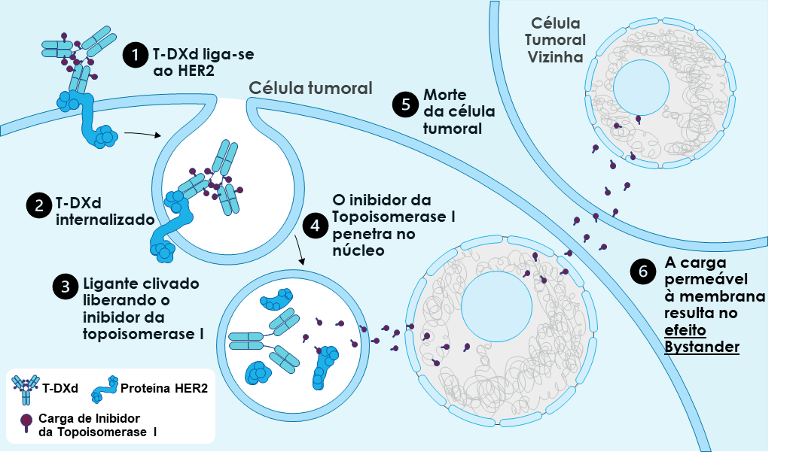
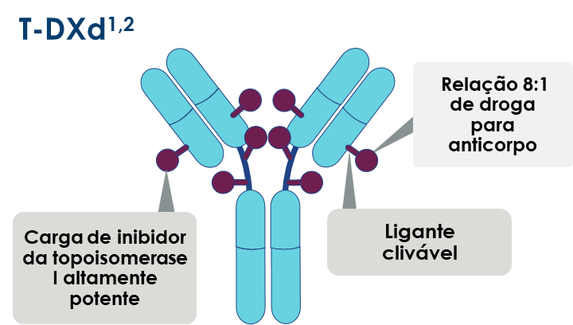
Novos Compostos Anti-HER2
Trastuzumabe deruxtecana
Evidences of activity in the HER2-Low subgroup
T-DXd: HER2-targeted antibody drug conjugate (ADC) with a topoisomerase I inhibitor payload
  A internalização do T-DXd leva à liberação da carga útil de DXd e subsequente morte celular nas células-alvo tumorais e nas células tumorais vizinhas através do efeito “Bystander”
Adaptado com permissão de Modi S, et al. J Clin Oncol 2020;38:1887-96. CC BY ND 4.0
Nakada T, et al. Chem Pharm Bull (Tokyo). 2019;67(3):173-185. Ogitani Y, et al. Clin Cancer Res. 2016;22(20):5097-5108
Trail PA, et al. Pharmacol Ther. 2018;181:126-142. Ogitani Y, et al. Cancer Sci. 2016;107(7):1039-1046
Diagramas cortesia: AstraZeneca
Notes:
Other anti-HER2 compounds (tyrosine kinase inhibitors, such as lapatinib, or antibody-drug conjugates such as T-DM1) are used mainly in the metastatic setting or within the context of clinical studies
In recent years new therapeutic compounds have been developed, in particular antibody drug conjugates (ADCs) that are designed to target and deliver chemotherapy inside cancer cells thus reducing systemic exposure to the cytotoxic agent (Fig. 4). The first in class ADC targeting HER2 is composed of trastuzumab and the cytotoxic agent emtansine (T-DM1) at a drug antibody ratio of 3.5. T-DM1 has showed superior efficacy and a favorable risk-benefit profile as compared with capecitabine plus lapatinib or treatment of the physician’s choice in two phase 3 trials involving patients with HER2-positive advanced breast cancer who had previously received HER2-targeted therapy including trastuzumab and chemotherapy [69–71]. T-DM1 is currently approved for use in patients with HER2-positive metastatic breast cancer who previously received treatment with trastuzumab and a taxane [72]. More recently, results from the Katherine study has shown a significant advantage for T-DM1 in patients with a residual disease following neoadjuvant trastuzumab-containing chemotherapy

Slide 8
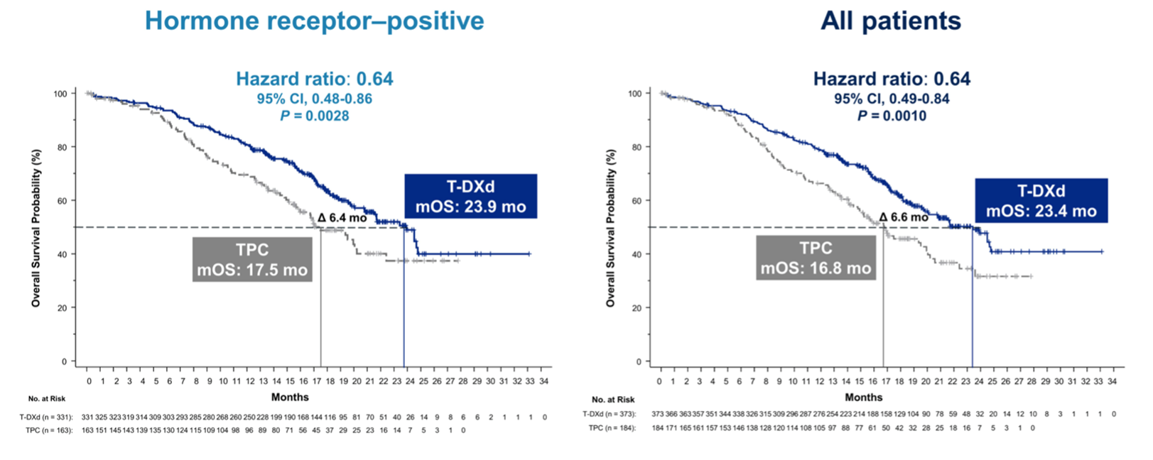
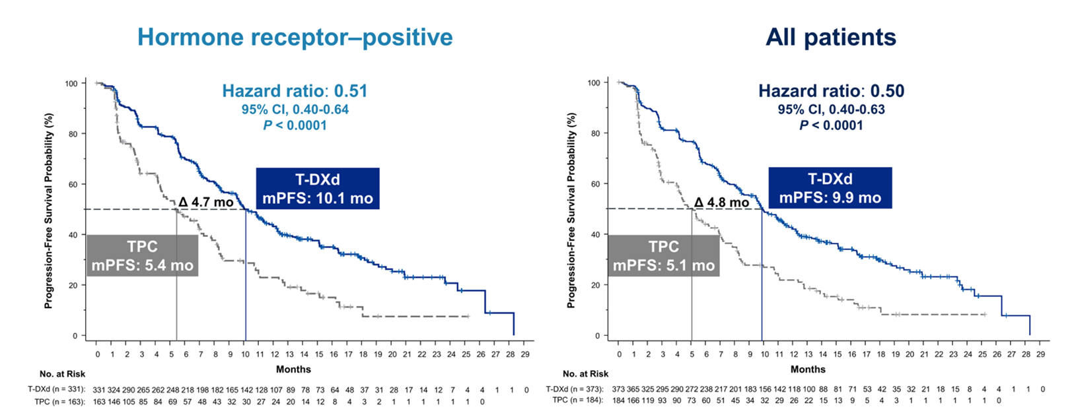
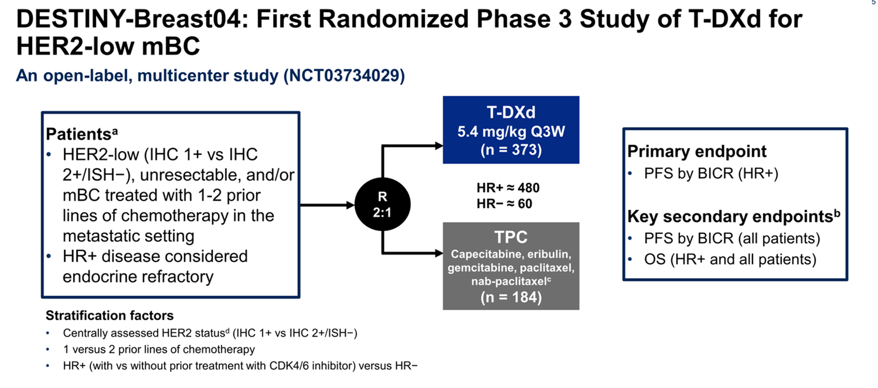
DESTINY Breast-04
Reduction in risk of disease progression or death by 50%
Benefit of trastuzumab deruxtecan (T-DXd) in patients with HER2-low advanced breast cancer
In HER2-low mBC, trastuzumab deruxtecan resulted in significantly longer PFS and OS than the physician’s choice of chemotherapy
VENTANA HER2/neu (4B5)
IUO Assay (investigational use only)
Modi et al, NEJM 2022
Notes:
Other anti-HER2 compounds (tyrosine kinase inhibitors, such as lapatinib, or antibody-drug conjugates such as T-DM1) are used mainly in the metastatic setting or within the context of clinical studies
In recent years new therapeutic compounds have been developed, in particular antibody drug conjugates (ADCs) that are designed to target and deliver chemotherapy inside cancer cells thus reducing systemic exposure to the cytotoxic agent (Fig. 4). The first in class ADC targeting HER2 is composed of trastuzumab and the cytotoxic agent emtansine (T-DM1) at a drug antibody ratio of 3.5. T-DM1 has showed superior efficacy and a favorable risk-benefit profile as compared with capecitabine plus lapatinib or treatment of the physician’s choice in two phase 3 trials involving patients with HER2-positive advanced breast cancer who had previously received HER2-targeted therapy including trastuzumab and chemotherapy [69–71]. T-DM1 is currently approved for use in patients with HER2-positive metastatic breast cancer who previously received treatment with trastuzumab and a taxane [72]. More recently, results from the Katherine study has shown a significant advantage for T-DM1 in patients with a residual disease following neoadjuvant trastuzumab-containing chemotherapy

Slide 9
HER2-Low Breast Cancer: Definition

Slide 10
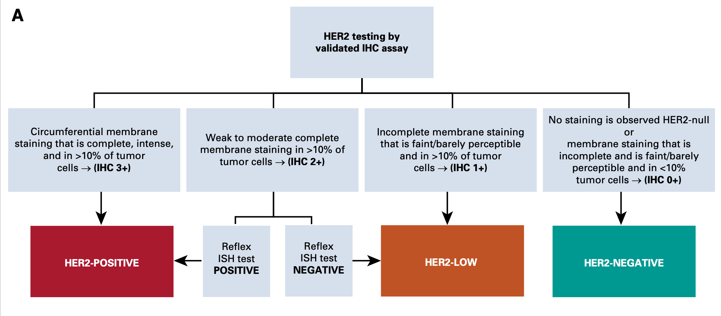
Câncer de Mama “HER2-Low”
Defining HER status as positive or negative in breast cancer is not enough anymore
Tarantino et al, JCO 2020
Notes:
Relaçao direta entre amplificaçào de HEr2 e expressão proteica
Alguns ADCs
The clinical definition of HER2 low is intrinsically
dependent on the testing technique and
currently can only be applied with the standard IHC/
ISH approach, because clear parameters that would
define a tumor as HER2 low using other assays have
not been formally established.

Slide 11
Câncer de Mama “HER2-Low”
Potential for HER2 targeting in HER2 “ultra-low” breast cancer
HER2 “ultra-low” breast cancer: HER2 score 0 with incomplete and faint staining in ≤10% of tumor cells
Notes:
Relaçao direta entre amplificaçào de HEr2 e expressão proteica
Alguns ADCs
The clinical definition of HER2 low is intrinsically
dependent on the testing technique and
currently can only be applied with the standard IHC/
ISH approach, because clear parameters that would
define a tumor as HER2 low using other assays have
not been formally established.

Slide 12
Mais da metade dos cânceres de mama atualmente categorizados como HER2-negativos expressam baixos níveis de HER2, o que pode ser clinicamente significativo
Paradigma passado recente
Paradigma presente e futuro
HER2+
HER2+
‘HER2-
positivo²’
RH+/HER2−
RH+/HER2−
As diretrizes recomendam a avaliação do status de HER2 em todas as pacientes recém-diagnosticadas com câncer de mama e naquelas que desenvolvem doença metastática ​
RH+/
Baixo HER2
~50% das pacientes com CM têm tumores que expressam baixos níveis de HER2^{1,4}
Atualmente
‘HER2-
negativo^{1,2}’
(˜85%)
RH−/HER2−
RH-/Baixo HER2
RH−/HER2−
Tarantino P, et al. J Clin Oncol 2020; Burstein HJ. N Engl J Med 2005; Wolff AC, et al. J Clin Oncol. 2018; Marchiò C, et al. Semin Cancer Biol. 2021

Slide 13
Clinicopathological Characteristics and Prognosis of HER2-Low Breast Cancer

Slide 14
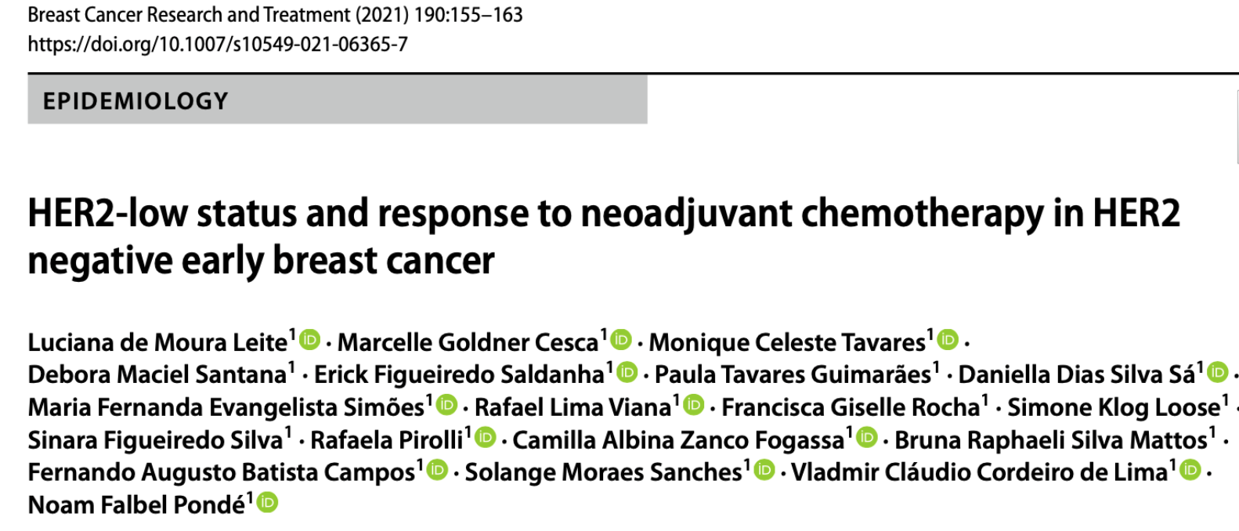
Câncer de Mama “HER2-Low”
Clinicopathologic features
HER2-low status: IHC 1+ or IHC2+/ISH-negative and HER2-zero was defined based on ASCO/CAP
Notes:
Other ADCs have been introduced, such as trastuzumab duocarmazine (SYD-985) and trastuzumab deruxtecan (DS-8201), which have demonstrated encouraging response rates not only in HER2-positive but also in the so called “HER2-low” breast cancer patients

Slide 15
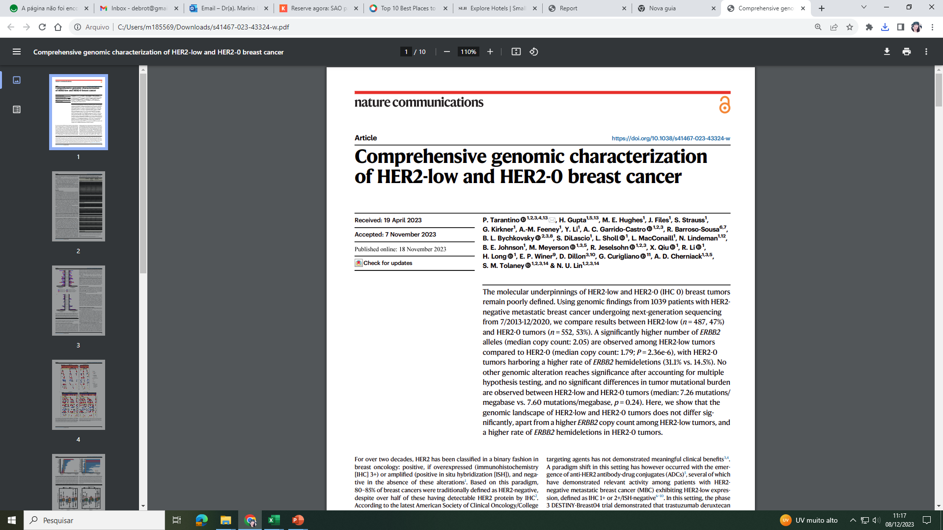
Câncer de Mama “HER2-Low”
Molecular findings
HER2-low status: IHC 1+ or IHC2+/ISH-negative and HER2-zero was defined based on ASCO/CAP
Notes:
Other ADCs have been introduced, such as trastuzumab duocarmazine (SYD-985) and trastuzumab deruxtecan (DS-8201), which have demonstrated encouraging response rates not only in HER2-positive but also in the so called “HER2-low” breast cancer patients

Slide 16
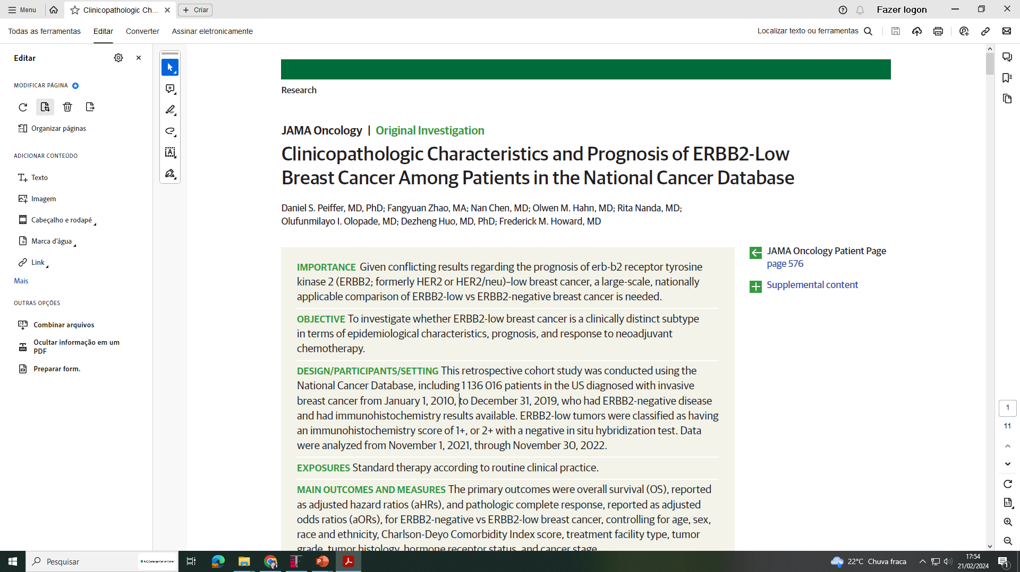
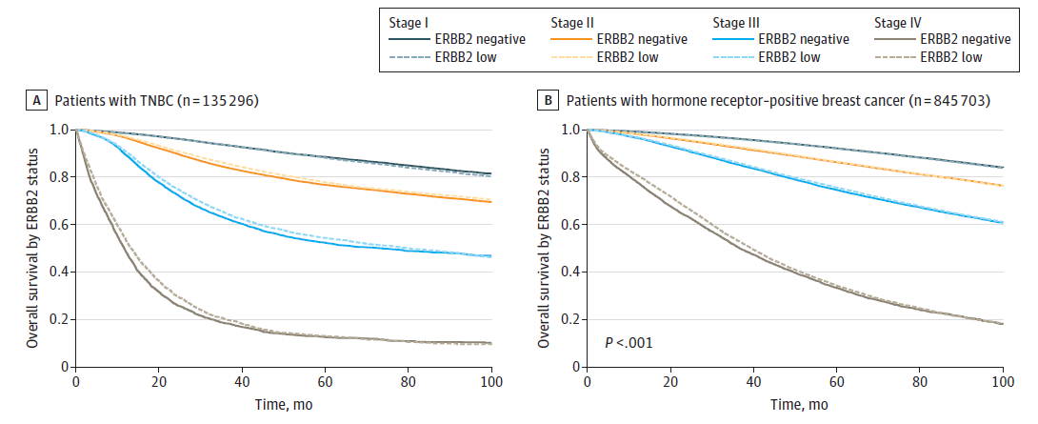
Câncer de Mama “HER2-Low”
A distinct prognostic entity?
Retrospective cohort study: National Cancer Database
2010-2019
1,136,016 patients
Only marginal differences in OS: practically overlapping curves
Peiffer D et al, 2023
Notes:
Other ADCs have been introduced, such as trastuzumab duocarmazine (SYD-985) and trastuzumab deruxtecan (DS-8201), which have demonstrated encouraging response rates not only in HER2-positive but also in the so called “HER2-low” breast cancer patients

Slide 17
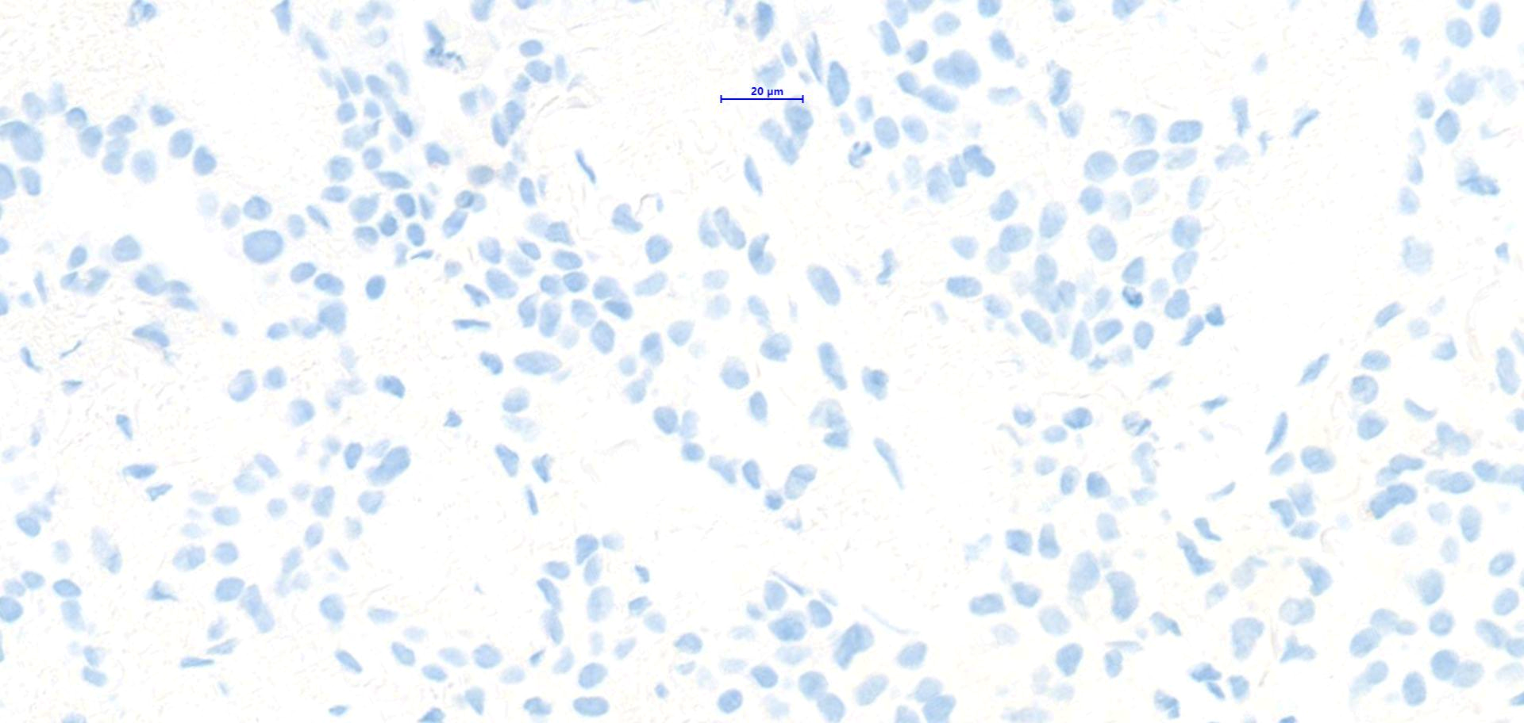
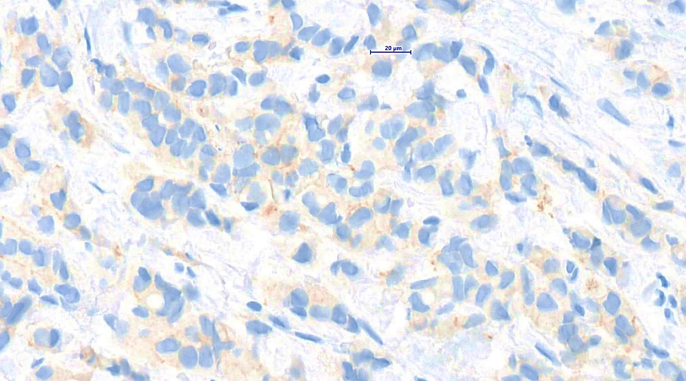
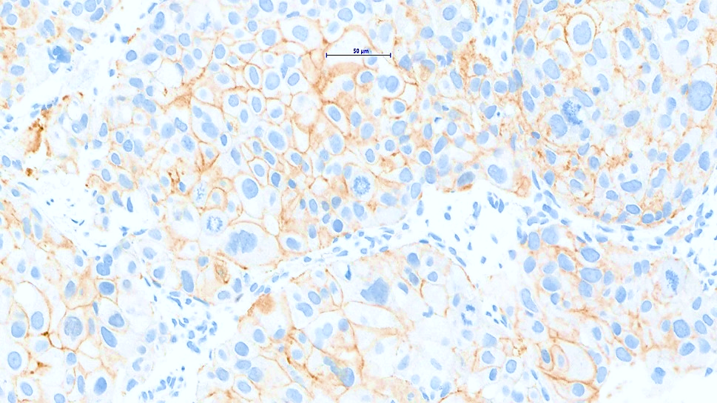
Câncer de mama “HER2-Low”
HER2-low não é um subtipo biológico distinto de BC, mas um biomarcador direcionável para T-DXd
  Not a new entity
  Not biologically distinct
  Do not show unique clinicopathological features
  No distinct genomic profile
  Not associated with a different benefit to therapy
  Prognosis: still controversial, but differences are minor
0
1+
2+
Notes:
Other ADCs have been introduced, such as trastuzumab duocarmazine (SYD-985) and trastuzumab deruxtecan (DS-8201), which have demonstrated encouraging response rates not only in HER2-positive but also in the so called “HER2-low” breast cancer patients

Slide 18
Desafios na Avaliação e Padronização de Laudos
Imuno-Histoquímicos Quanto à Expressão de HER2:
O que fazer?

Slide 19
Desafios na Avaliação do HER2
Concordância interobservador
DESTINY-Breast04: Central Lab HER2 IHC Testing of Samples
Tumor samples from patients that were historically scored as IHC 1+ or IHC 2+/ISH– were submitted for central confirmation of HER2-low status
823/1060 (78%) samples designated as HER2-low by prior historical (local) results were confirmed as HER2-low by central testing
Among the 22% (237/1060) of discordant samples, 208/237 (88%) were centrally scored IHC 0, and 29/237 (12%) were scored as IHC 2+/ISH+ or IHC 3+
HER2 Status by Central Testing, n | HER2 Status by Historical Result, n |  |  |  | Total
HER2 Status by Central Testing, n | IHC 0 | IHC 1+ | IHC 2+/ISH− | IHC 2+/ISH+ | Total
IHC 0 | 18 | 157 | 51 | 2 | 228
IHC 1+ | 18 | 344 | 126 | 3 | 491
IHC 2+/ISH− | 5 | 122 | 231 | 0 | 358
IHC 2+/ISH+ | 0 | 9 | 11 | 1 | 21
IHC 3+ | 1 | 2 | 7 | 0 | 10
Total | 42 | 634 | 426 | 6 | 1108
Prat A et al. San Antonio Breast Cancer Symposium 2022; December 5-9, 2022; San Antonio, TX. Poster HER2-18
Notes:
Other ADCs have been introduced, such as trastuzumab duocarmazine (SYD-985) and trastuzumab deruxtecan (DS-8201), which have demonstrated encouraging response rates not only in HER2-positive but also in the so called “HER2-low” breast cancer patients

Slide 20
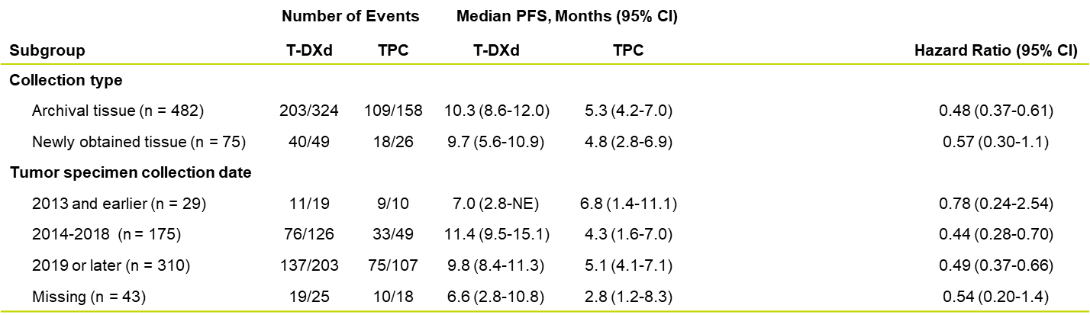
Desafios na Avaliação do HER2
Fatores associados a maior concordância
DESTINY-Breast04: Central Lab HER2 IHC Testing of Samples
Efficacy of T-DXd versus TPC for patients in DESTINY-Breast04 was generally consistent regardless of collection type and tissue collection date
Prat A et al. San Antonio Breast Cancer Symposium 2022; December 5-9, 2022; San Antonio, TX. Poster HER2-18
Notes:
Other ADCs have been introduced, such as trastuzumab duocarmazine (SYD-985) and trastuzumab deruxtecan (DS-8201), which have demonstrated encouraging response rates not only in HER2-positive but also in the so called “HER2-low” breast cancer patients

Slide 21
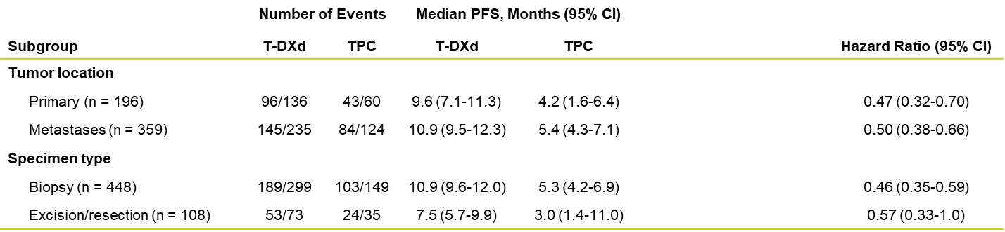
Desafios na Avaliação do HER2
Fatores associados a maior concordância
DESTINY-Breast04: Central Lab HER2 IHC Testing of Samples
Efficacy of T-DXd versus TPC for patients in DESTINY-Breast04 was consistent regardless of
tumor location and specimen type
Prat A et al. San Antonio Breast Cancer Symposium 2022; December 5-9, 2022; San Antonio, TX. Poster HER2-18
Notes:
Other ADCs have been introduced, such as trastuzumab duocarmazine (SYD-985) and trastuzumab deruxtecan (DS-8201), which have demonstrated encouraging response rates not only in HER2-positive but also in the so called “HER2-low” breast cancer patients

Slide 22


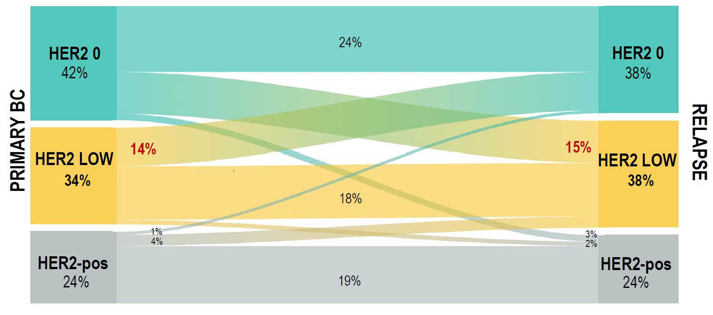
Evolução da Baixa Expressão de HER2 no Câncer de Mama Primário x Recidivas de Acordo com o Fenótipo do Tumor
A baixa expressão de HER2 é altamente instável durante a evolução da doença
A taxa geral de discordância de HER2 foi de 39%: principalmente representada por HER2-0 mudando para HER2-Low (15%) e HER2-Low mudando para HER2-0 (14%)
Entre os pacientes com tumor primário HER2-negativo, a taxa de discordância de HER2 foi maior nos casos HR+/HER2-negativo versus TN
Biópsia de recidiva em um caso de tumor primário HER2-0 pode abrir novas oportunidades de tratamento em proporção relevante de pacientes
Os níveis podem mudar, principalmente à medida que a doença progride
O status de HER2 pode mudar de negativo para positivo (e vice-versa), entre tumores primários e metastáticos
Slide cortesia: AstraZeneca
HER2-negative cases were sub-classified as HER-2 low (IHC 1+, or IHC 2+ and ISH no amplified), or HER-0 (IHC 0)
ASCO, American Society of Clinical Oncology; CAP, College of American Pathologists; TN, triple-negative
Miglietta F, et al. Oral presented at ESMO Breast Cancer Virtual Congress 2021 (Abstract 4MO_PR)

Slide 23
Desafios na Avaliação do HER2
Considerable interobserver variability for HER2-Low determination: 26-88% (concordance is not optimal in many studies)
IHC HER2 test was not designed to identify these patients
Many labs do not use the VENTANA platform and the 4B5 antibody used in the DESTINY-Breast04 trial
Sensitivity for identifying HER2 1+ cases varies among different assays: HercepTest > 4B5
Preanalytical factors have critical importance
Schettini et al, 2021; Fernandez et al, 2022; Prat A et al, SABCS 2022
Image: CAP Today Online October 2022
Notes:
Other ADCs have been introduced, such as trastuzumab duocarmazine (SYD-985) and trastuzumab deruxtecan (DS-8201), which have demonstrated encouraging response rates not only in HER2-positive but also in the so called “HER2-low” breast cancer patients

Slide 24
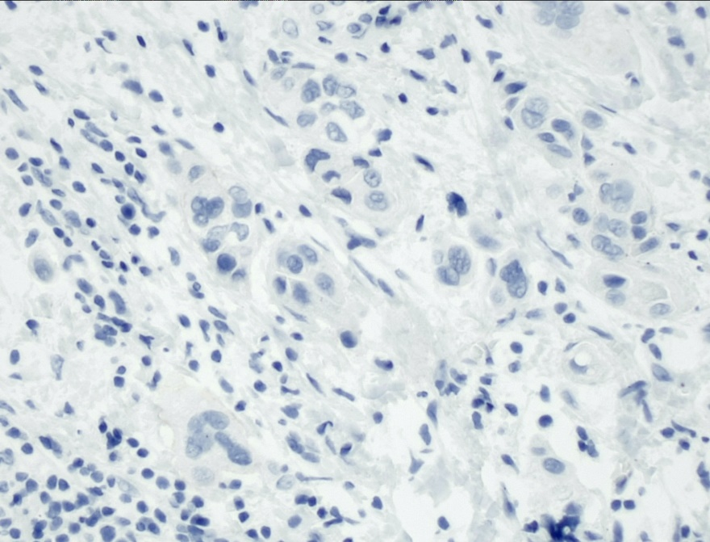
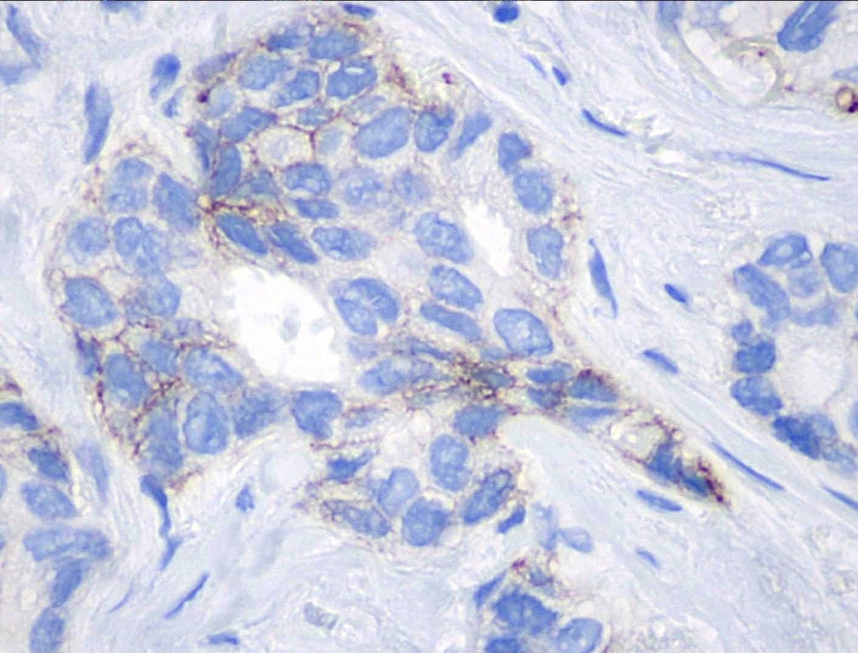
Distinção entre Escore 0 e 1+
Slide cortesia: AstraZeneca
0
Particularmente sensível a
condições pré-analíticas e analíticas
Não tinha implicação clínica até recentemente
Discordância inter-observador:
35% (particularmente entre 0/1+)
1+
Concordância interlaboratórios:
≤70% (>1300 laboratórios)
Concordância interpatologistas:
26% (18 patologistas)
Najjar e Allison. Virchows Arch 2022; Schettini et al. Npj Breast Cancer 2021; Fernandez et al. JAMA Oncol 2022

Slide 25
Identification of Membrane Staining Patterns and Artifacts
Accepted staining patterns
Patterns not accepted
Linear complete basolateral (“U-shaped”)
Diffuse cytoplasmic and background staining (“cytoplasmic blush”)
Linear incomplete
Granular cytoplasmic and nuclear staining
Linear clustered (“beads on string”/tipo “colar de pérolas”)
BM-like only (no supporting data)
Accentuated at cell junctions
Luminal or extracellular only
Najjar e Allison. Virchows Arch 2022; Schettini et al. Npj Breast Cancer 2021; Fernandez et al. JAMA Oncol 2022

Slide 26
Identification of Artifacts and Pitfalls
Artifacts and pitfalls
Surgical ink
Electrocautery, thermal, crush artifact
Edge effect
Retraction and open spaces
Do not include DCIS foci, necrosis and apoptosis in the scoring
Najjar e Allison. Virchows Arch 2022; Schettini et al. Npj Breast Cancer 2021; Fernandez et al. JAMA Oncol 2022

Slide 27
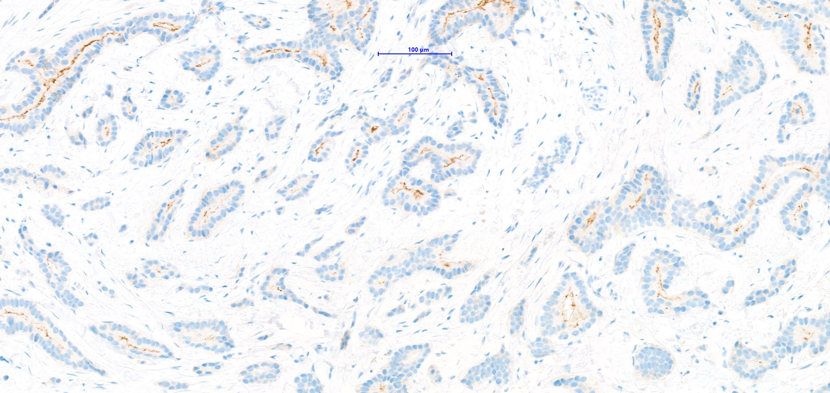
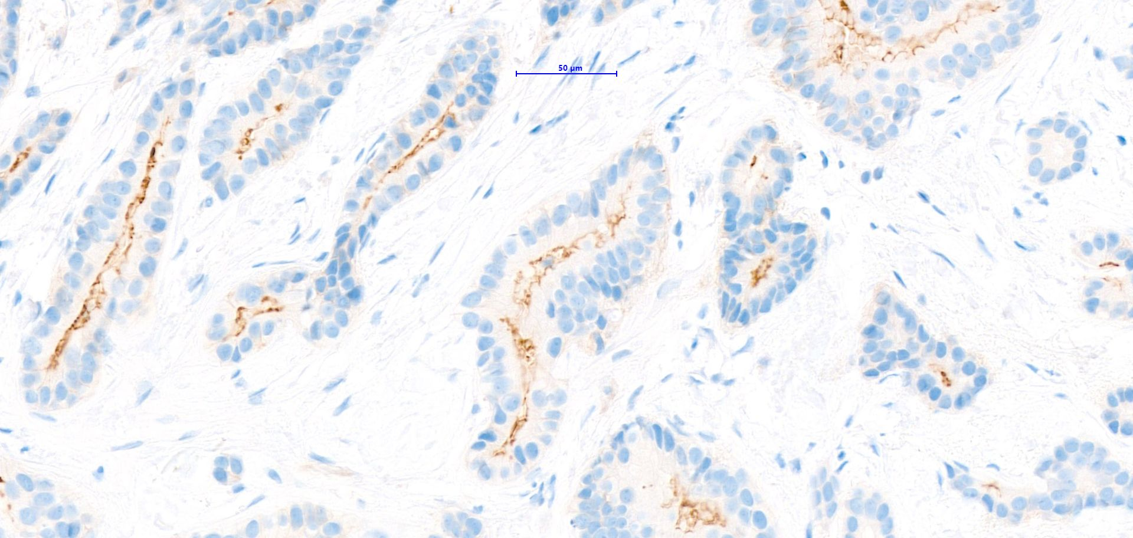
Pattern of staining: Luminal-only

Slide 28
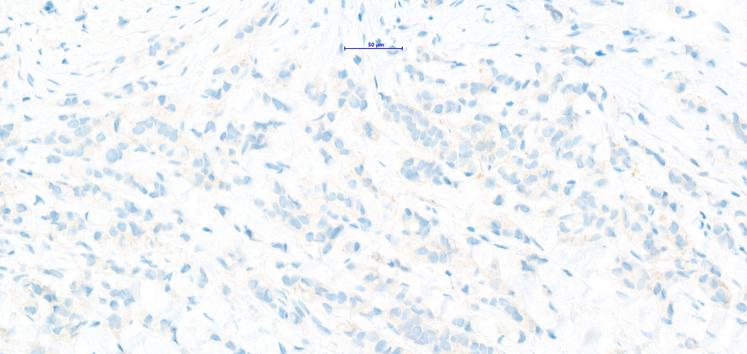
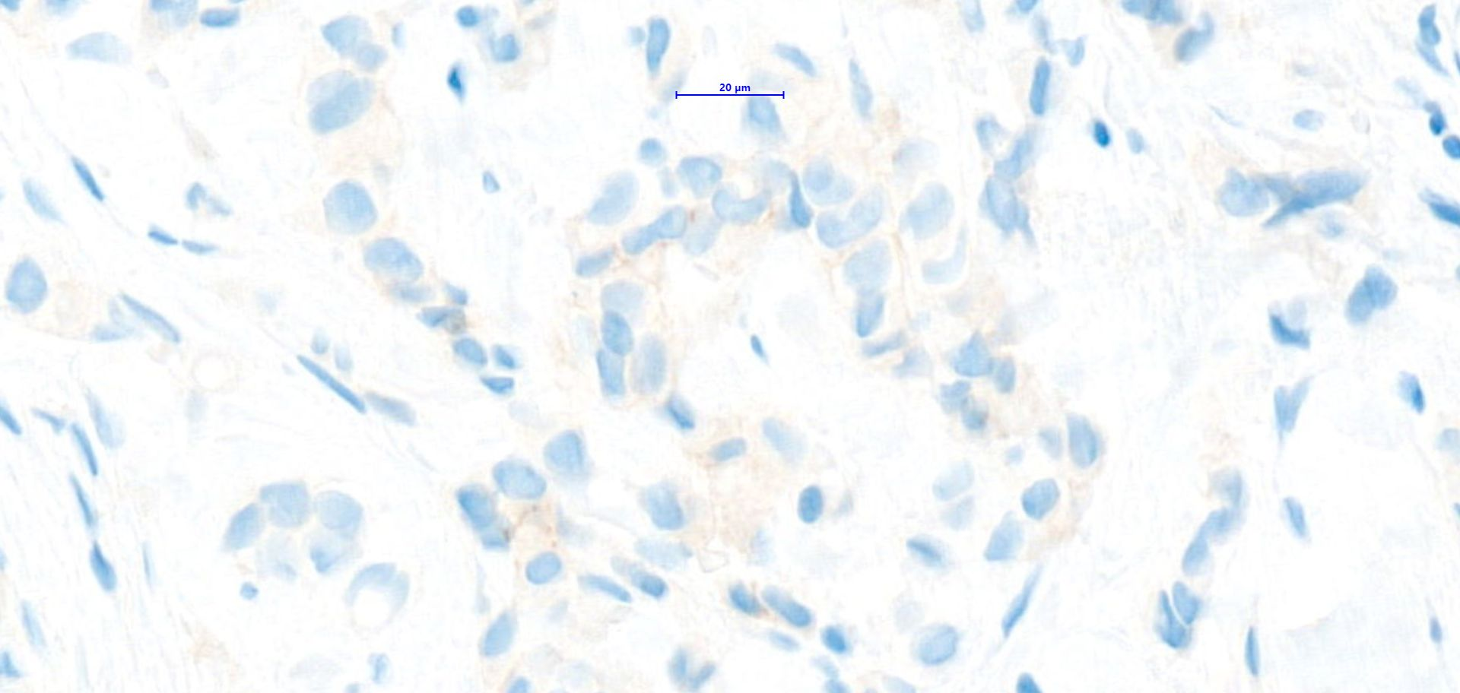
Pattern of staining: Granular cytoplasmic

Slide 29
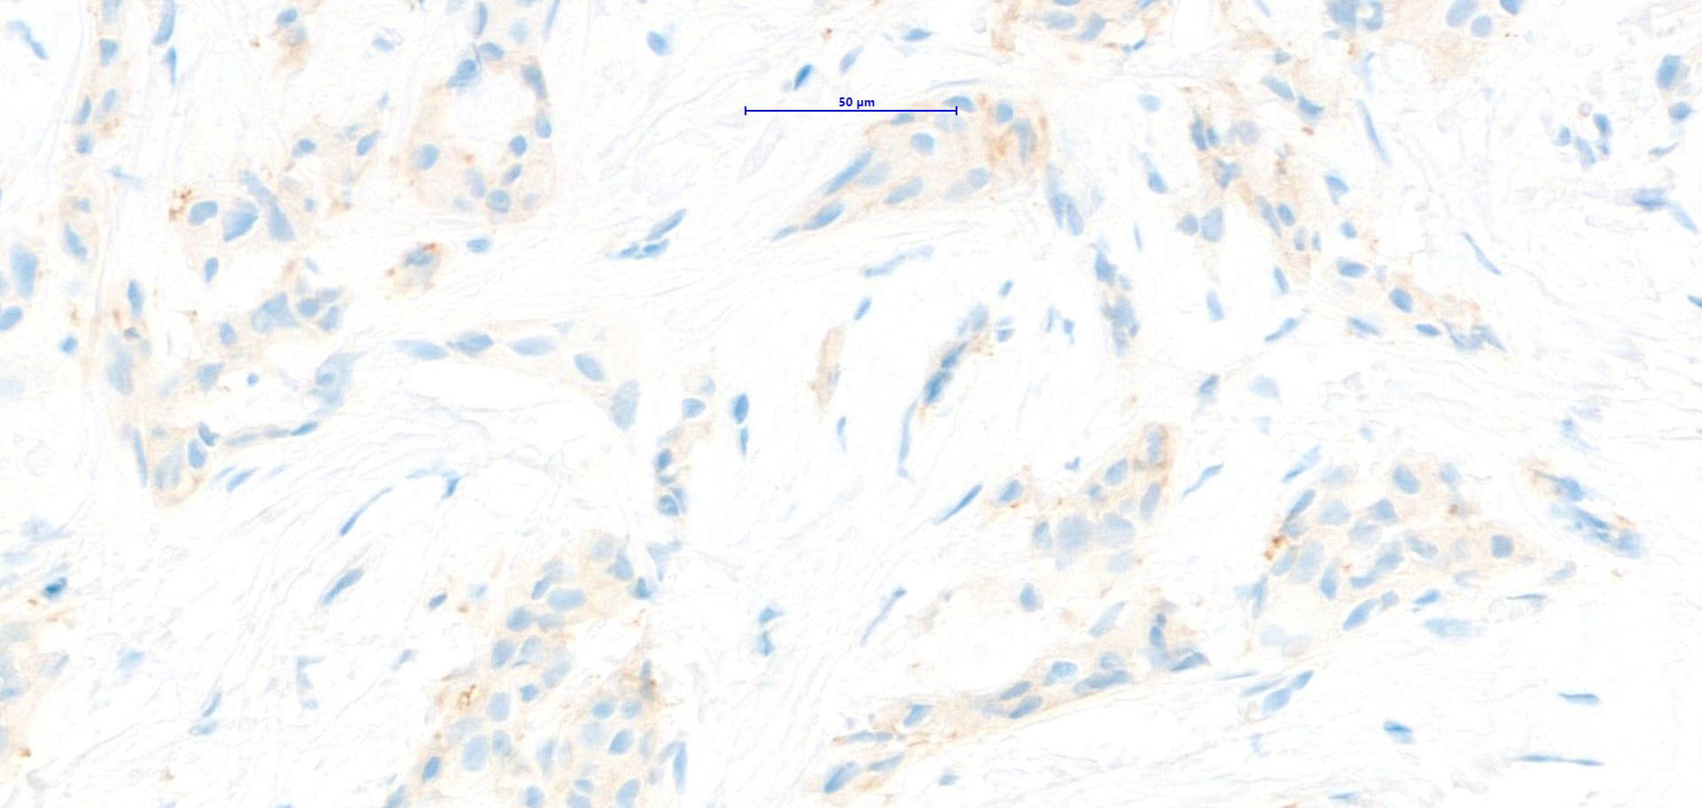
Pattern of staining: Granular cytoplasmic

Slide 30
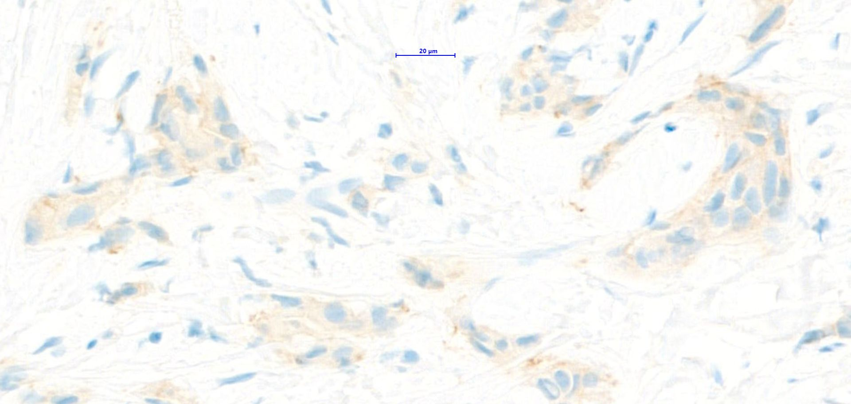
Pattern of staining: Granular cytoplasmic

Slide 31
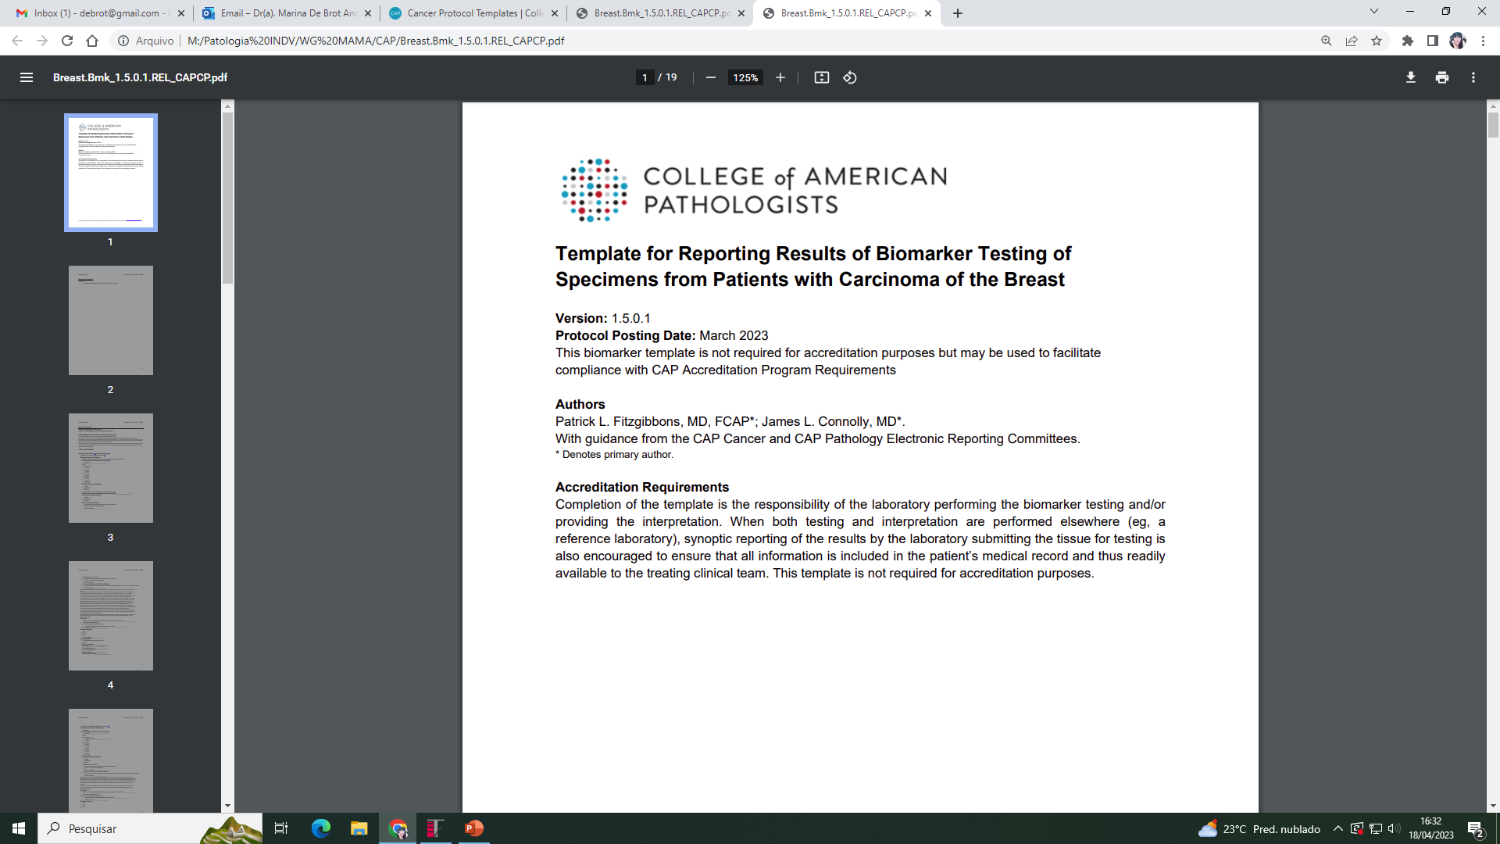
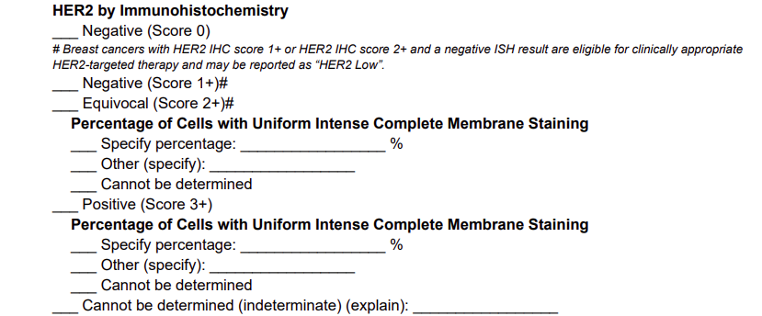
Padronização de Laudos
O que fazer?

Slide 32
Padronização de Laudos
O que fazer?

Slide 33
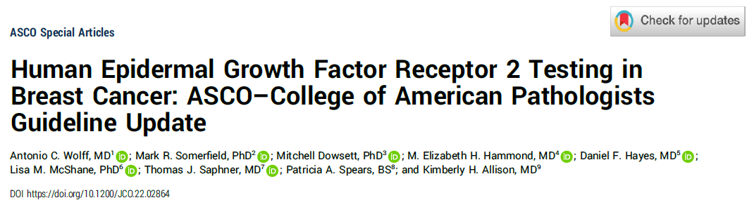
Padronização de Laudos
O que fazer?
HER2 testing guidelines have focused on detecting HER2 protein overexpression or gene amplification in breast cancer: to identify patients for therapies that disrupt HER2 signaling
This update: acknowledges a new indication for trastuzumab deruxtecan when HER2 is not overexpressed or amplified but is IHC 1+ or 2+ without amplification by ISH
Adoption of HER2-Low terminology in IHC reporting is problematic
  It would require changing the reporting schema for IHC 2+ results: currently reported as equivocal for protein overexpression with reflex ISH testing required to determine gene amplification status
Wolff AC et al, 2023

Slide 34
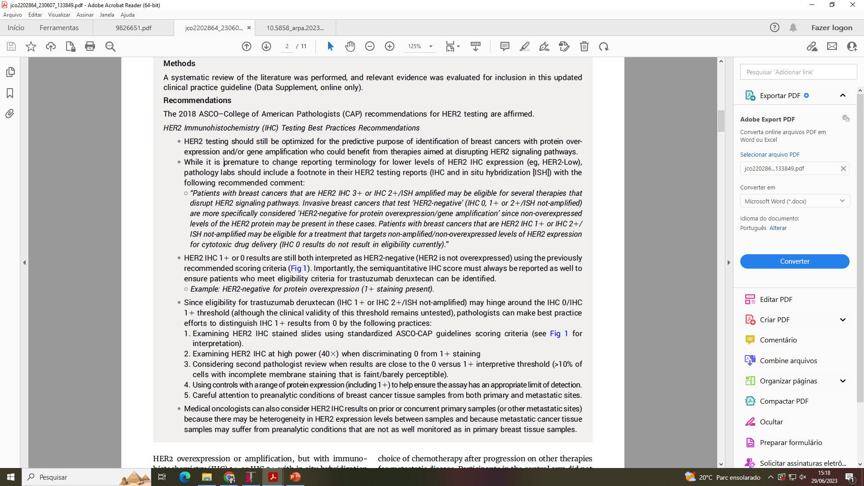
Padronização de Laudos
O que fazer?
Wolff AC et al, 2023
Pathology labs should include a footnote in their HER2 testing reports:
  IBCs that test “HER2-negative” (IHC 0, 1+ or 2+/ISH not-amplified) are more specifically considered “HER2-negative for protein overexpression/gene amplification” since non-overexpressed levels of the HER2 protein may be present in these cases
  Patients with breast cancers that are HER2 IHC 1+ or IHC 2+/ISH not-amplified may be eligible for a treatment that targets non-amplified/non-overexpressed levels of HER2 expression for cytotoxic drug delivery (IHC 0 results do not result in eligibility currently)

Slide 35

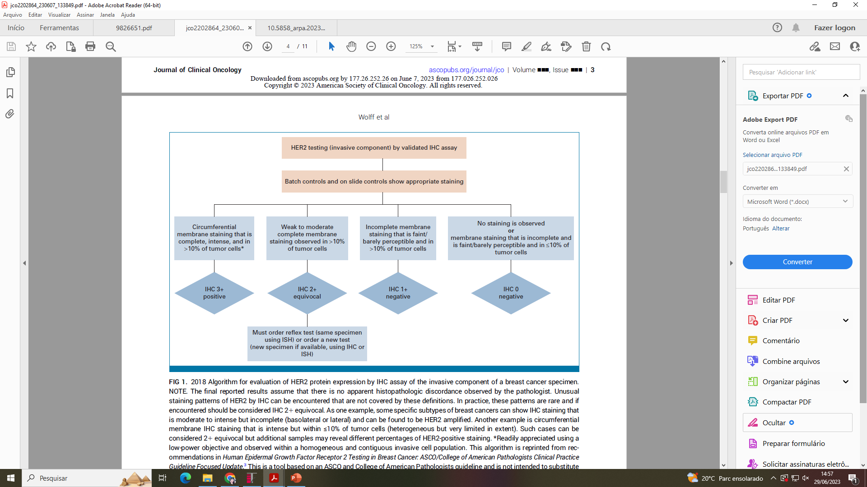
HER2 IHC 1+ or 0 results are still both interpreted as HER2-negative: HER2 is not overexpressed
Utilize previously recommended scoring criteria
Importantly, the semiquantitative IHC score must always be reported as well to ensure patients who meet eligibility criteria for trastuzumab deruxtecan can be identified
Example: HER2-negative for protein overexpression (score 1+ or 1+ staining present)

Slide 36
Padronização de Laudos
O que fazer?
Best practice efforts to distinguish IHC 1+ results from 0:
  Examining HER2 IHC stained slides using standardized ASCO-CAP guidelines scoring criteria
  Examining HER2 IHC at high power (40x) when discriminating 0 from 1+ staining
  Considering second pathologist review when results are close to the 0 versus 1+ interpretive threshold (>10% of cells with incomplete membrane staining that is faint/barely perceptible)
  Using controls with a range of protein expression (including 1+) to help ensure the assay has an appropriate limit of detection
  Careful attention to preanalytical conditions of breast cancer tissue samples from both primary and metastatic sites
Wolff AC et al, 2023

Slide 37
Padronização de Laudos
O que fazer?
Medical oncologists can also consider HER2 IHC results on prior or concurrent primary samples (or other metastatic sites)
There may be heterogeneity in HER2 expression levels between samples and because metastatic cancer tissue samples may suffer from preanalytic conditions: not as well monitored as in primary breast tissue samples
Wolff AC et al, 2023

Slide 38

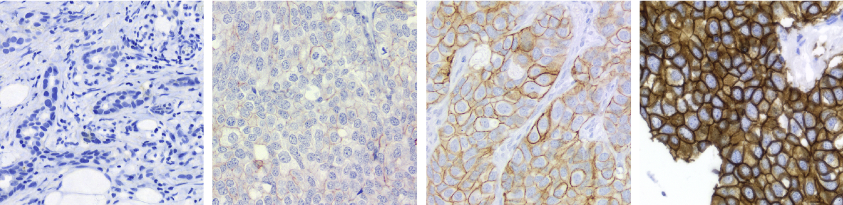
Guidelines da ASCO/CAP de 2023
IHQ 0
IHQ 1+
IHQ 2+
IHQ 3+
Sem coloração OU coloração fraca e incompleta em ≤10% das células tumorais
Coloração fraca e incompleta em >10% das células tumorais
Coloração completa fraca a moderada em >10% das
células tumorais
Coloração completa e intensa em >10% das células tumorais
HER2 negativo
HER2 positivo
Slide cortesia: AstraZeneca

Slide 39
So, what should we do for now?
ACCCC reporting of IHC HER2 results
Padronização de Laudos
Protocolo do ACCCC
Results of IHC assessment and interpretation of HER2 (Clone/Source)
  Negative (score 0) for HER2 overexpression
  Percentage of tumor cells with membrane staining: 0%
  Score 0 (Negative for HER2 overexpression)
  Percentage of tumor cells with incomplete and faint membrane staining: __%
  Score 1+ or 2+ (Negative/Equivocal for HER2 overexpression)
  Percentage of tumor cells with complete and faint/moderate membrane staining: __%
  Percentage of tumor cells with complete, strong and circumferential staining: __%
Nota:
Câncer de mama com baixa expressão de HER2 (do inglês, “HER2-Low)
Definição
Predição de resposta ao T-DXd
Notes:
Other ADCs have been introduced, such as trastuzumab duocarmazine (SYD-985) and trastuzumab deruxtecan (DS-8201), which have demonstrated encouraging response rates not only in HER2-positive but also in the so called “HER2-low” breast cancer patients

Slide 40
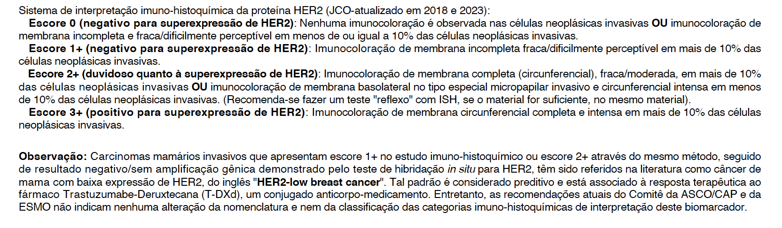
So, what should we do for now?
ACCCC reporting of IHC HER2 results
Padronização de Laudos
Protocolo do ACCCC
Nota:
Câncer de mama com baixa expressão de HER2 (do inglês, “HER2-Low)
Definição
Predição de resposta ao T-DXd
Notes:
Other ADCs have been introduced, such as trastuzumab duocarmazine (SYD-985) and trastuzumab deruxtecan (DS-8201), which have demonstrated encouraging response rates not only in HER2-positive but also in the so called “HER2-low” breast cancer patients

Slide 41
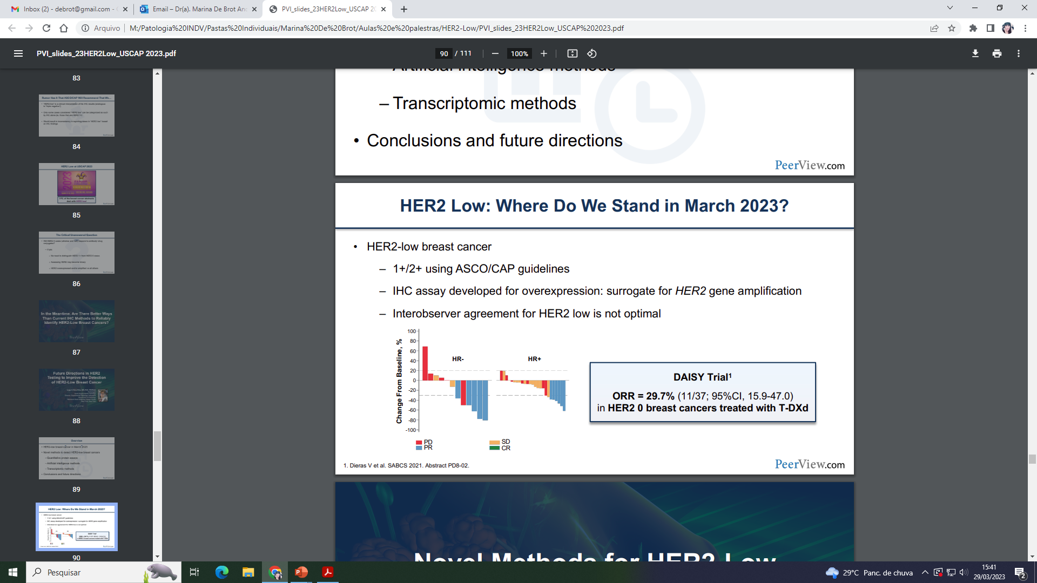
Desafios na Avaliação de HER2
Will HER2 cases ultralow and null respond to antibody-drug conjugates?
If yes
  No need to make the distinction between HER2 0 and 1+
  HER2 status may become binary: HER2-overexpressed/amplified vs others
  If it is necessary to distinguish null vs low levels of expression: new methods for HER evaluation to improve quantification and reduce false negatives
  Quantitative protein assays; transcriptomic methods (gene expression assays); AI
Dieras V et al, SABCS 2021
Notes:
Other ADCs have been introduced, such as trastuzumab duocarmazine (SYD-985) and trastuzumab deruxtecan (DS-8201), which have demonstrated encouraging response rates not only in HER2-positive but also in the so called “HER2-low” breast cancer patients

Slide 42
Caso 1

Slide 43
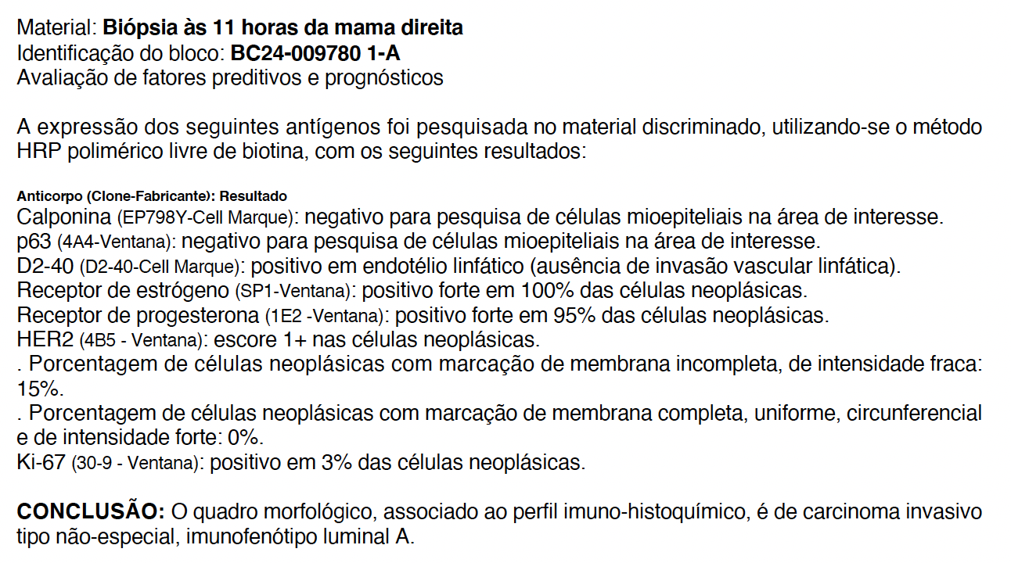
Caso 1

Slide 44
Caso 2

Slide 45
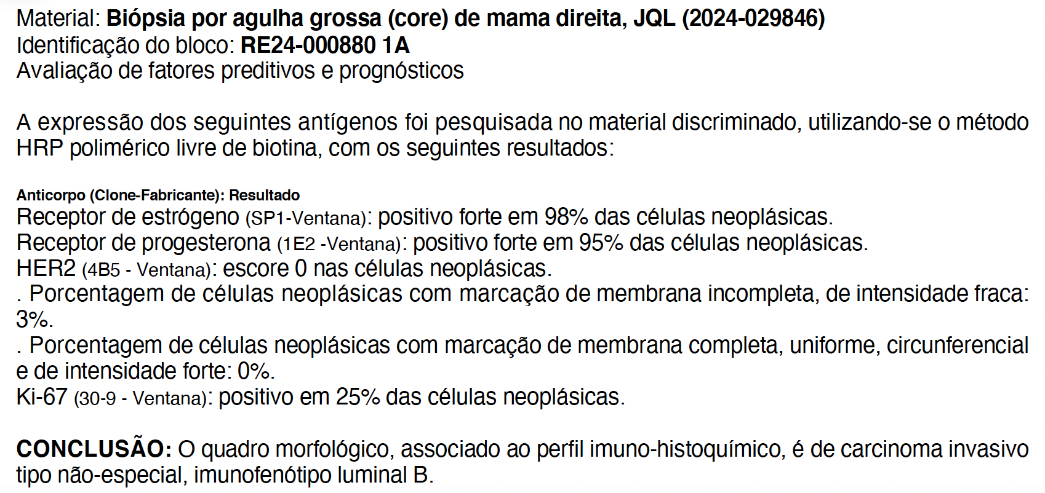
Caso 2

Slide 46
Caso 3

Slide 47
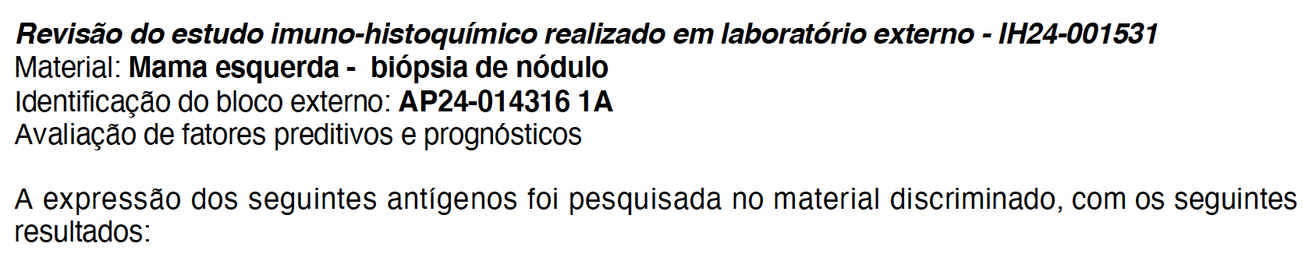
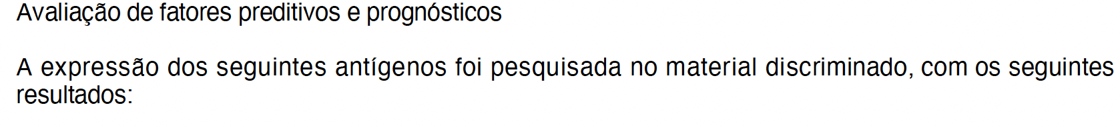
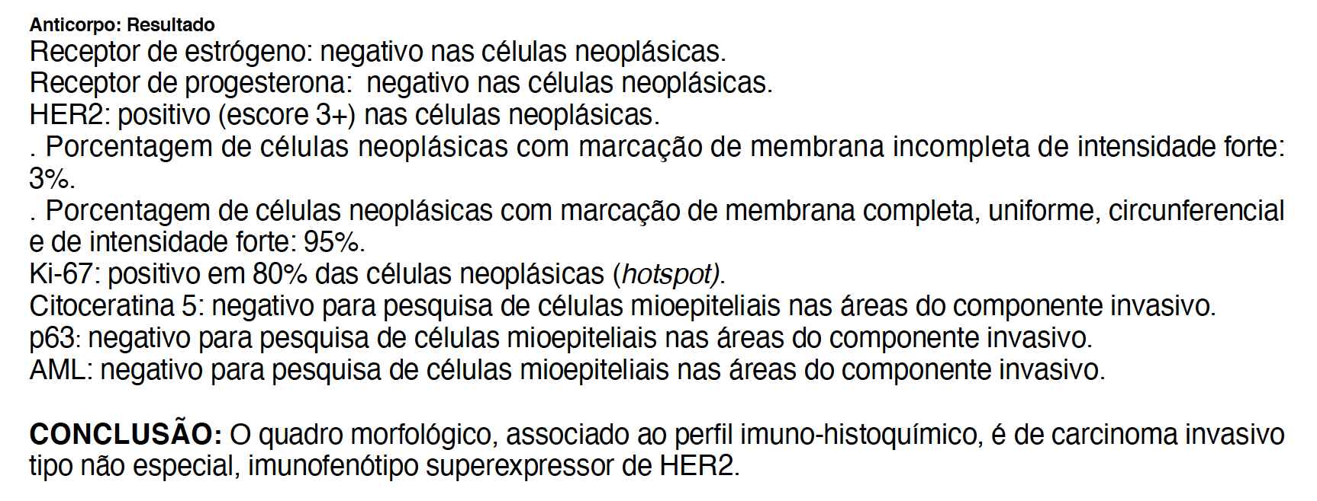
Caso 3

Slide 48
Caso 4

Slide 49
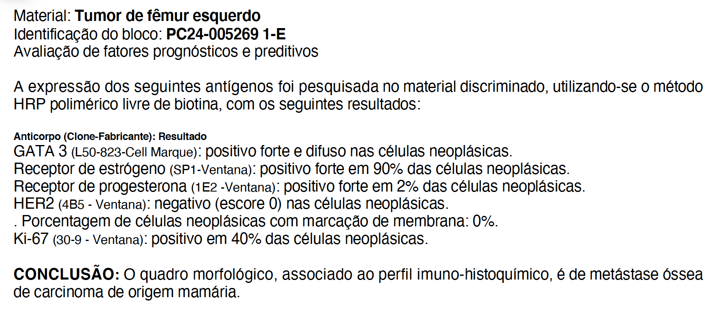
Caso 4

Slide 50
Caso 5

Slide 51
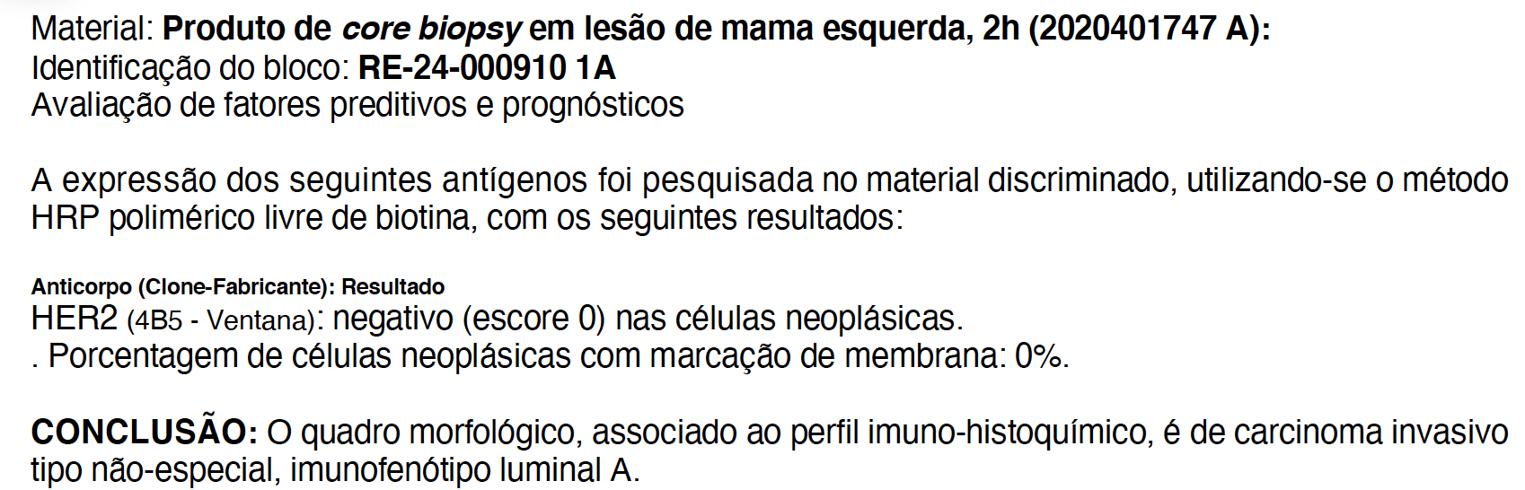
Caso 5

Slide 52
Caso 6

Slide 53
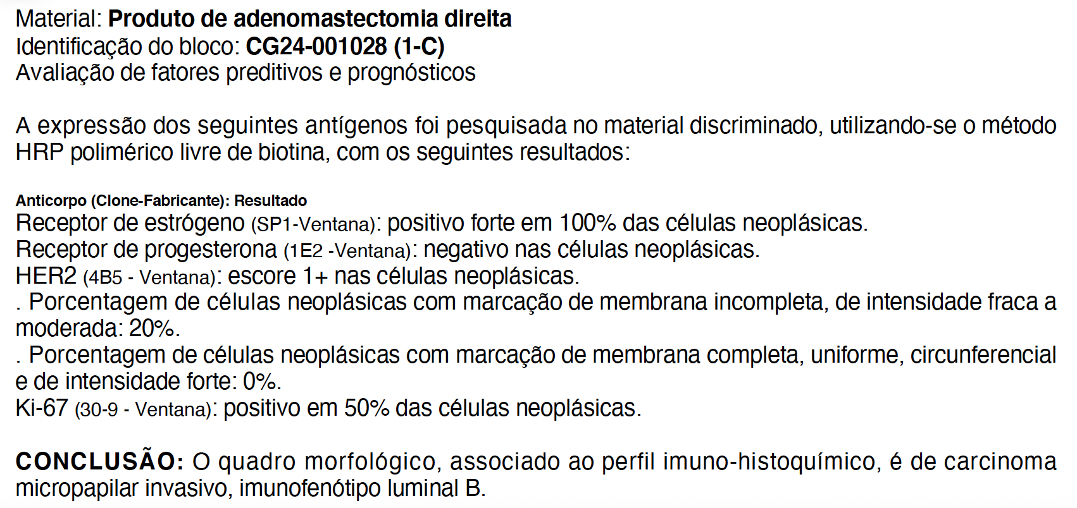
Caso 6

Slide 54
Caso 7

Slide 55
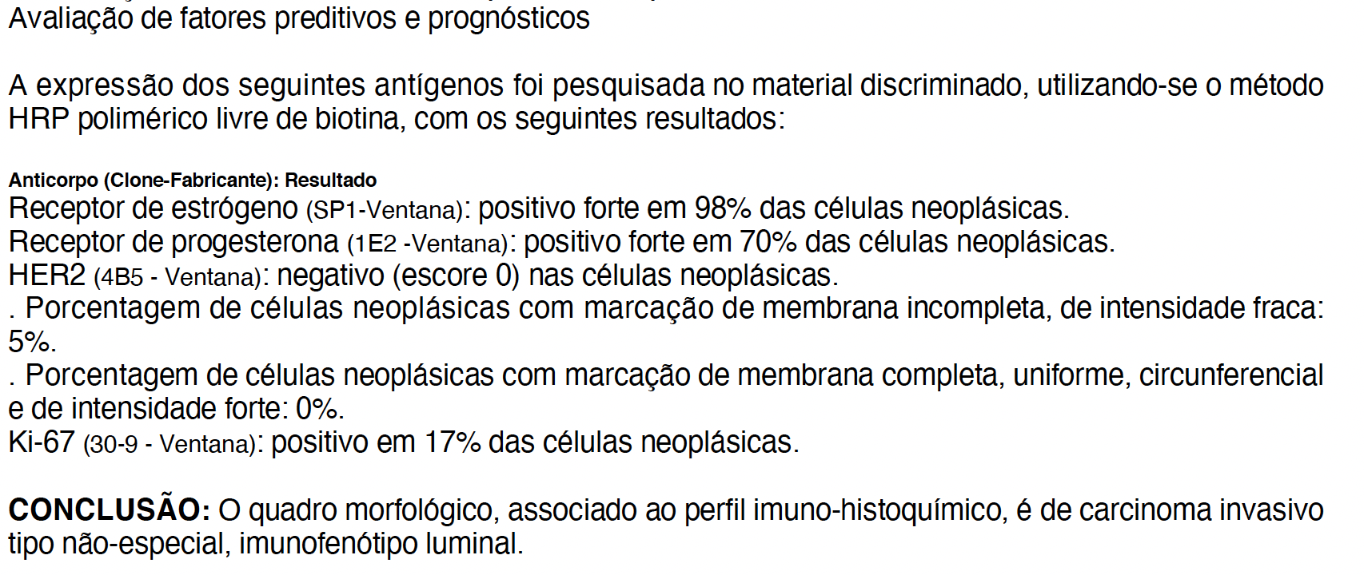
Caso 7

Slide 56
Caso 8

Slide 57
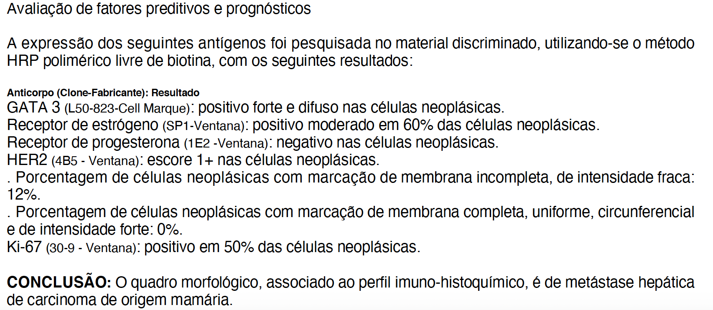
Caso 8

Slide 58
Caso 9

Slide 59
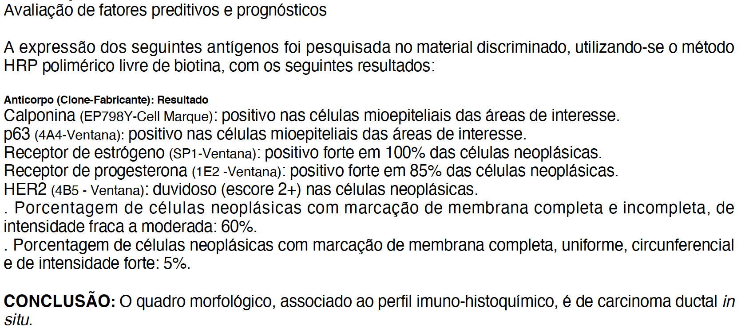
Caso 9

Slide 60
Caso 10

Slide 61

Caso 10

Slide 62
Caso 11

Slide 63


Caso 11

Slide 64
Caso 12

Slide 65

Caso 12

Slide 66
Caso 13

Slide 67


Caso 13

Slide 68

Caso 13

Slide 69
Caso 14

Slide 70

Caso 14

Slide 71
Caso 15

Slide 72

Caso 15

Slide 73
Caso 16

Slide 74

Caso 16

Slide 75
Caso 17

Slide 76

Caso 17

Slide 77
Take-Home Messages
Câncer de Mama HER2-Low
Introdução de novos compostos anti-HER2: está modificando os paradigmas da avaliação do HER2 no câncer de mama
Pacientes com tumores com baixos níveis de expressão de HER2 são beneficiados com novas terapias anti-HER2, principalmente ADCs
HER2-low: escores 1+e 2+/ISH negativo
HER2-ultralow: escore 0 com marcação em até 10% das células neoplásicas
Notes:
The introduction of novel anti-HER2 compounds, however, is
changing this paradigm because some breast cancers with lower levels of protein
expression (i.e. score 1+/2+ with no gene amplification) benefited from
HER2 antibody-drug conjugates (ADC).
Pathologists and oncologists are currently putting efforts into
defining all possible HER2 entities for achieving the most
accurate stratification of the patients and the selection of an
appropriate therapeutic approach. In this regard, remarkable
endeavors aimed to deepen into the clinical and molecular
landscape of HER2-low breast cancer
A further step in the development of HER2-low BC treatment is coming from the evaluation of new treatment combination strategies. Considering ADC’s ability to induce immunogenic cell death and thereby an immune-hot tumor microenvironment, further results from studies evaluating ADCs in combination with ICIs are eagerly expected.
Combined with ET, new anti-HER2 agents, like zenocutuzumab, could provide a new, chemotherapy-free approach for patients with endocrine-resistant HER2-low BC.
Collectively, these new agents are building the foundations for the exciting new field of HER2-low BC treatment.

Slide 78
Take-Home Messages
Câncer de Mama HER2-Low
ASCO/CAP nomenclature need to be maintained in the report: include score 0/1+/2+/3+
Use of the term “HER2-Low” is not mandatory in the pathology report, but may be used: CAP Biomarkers Protocol March 2023
ASCO/CAP Guidelines 2023:
  Include footnote comment about HER2-Low breast cancer
  Negative for HER2 overexpression/gene amplification
Examine at high-power (40x): to distinguish 0 from 1+
Borderline cases should be reviewed by other pathologists
Notes:
The introduction of novel anti-HER2 compounds, however, is
changing this paradigm because some breast cancers with lower levels of protein
expression (i.e. score 1+/2+ with no gene amplification) benefited from
HER2 antibody-drug conjugates (ADC).
Pathologists and oncologists are currently putting efforts into
defining all possible HER2 entities for achieving the most
accurate stratification of the patients and the selection of an
appropriate therapeutic approach. In this regard, remarkable
endeavors aimed to deepen into the clinical and molecular
landscape of HER2-low breast cancer
A further step in the development of HER2-low BC treatment is coming from the evaluation of new treatment combination strategies. Considering ADC’s ability to induce immunogenic cell death and thereby an immune-hot tumor microenvironment, further results from studies evaluating ADCs in combination with ICIs are eagerly expected.
Combined with ET, new anti-HER2 agents, like zenocutuzumab, could provide a new, chemotherapy-free approach for patients with endocrine-resistant HER2-low BC.
Collectively, these new agents are building the foundations for the exciting new field of HER2-low BC treatment.

Slide 79
marina.debrot@accamargo.org.br
@DebrotMarina
Obrigada!
Marina De Brot, MD PhD
Patologista Titular e Professora do Programa de Pós-Graduação do A.C.Camargo Cancer Center
Presidente da Associação dos Patologistas do Estado de São Paulo (APESP)
Secretária-Geral da Sociedade Brasileira de Patologia (SBP)
Secretária da International Society of Breast Pathology (ISBP)

